Slide 1
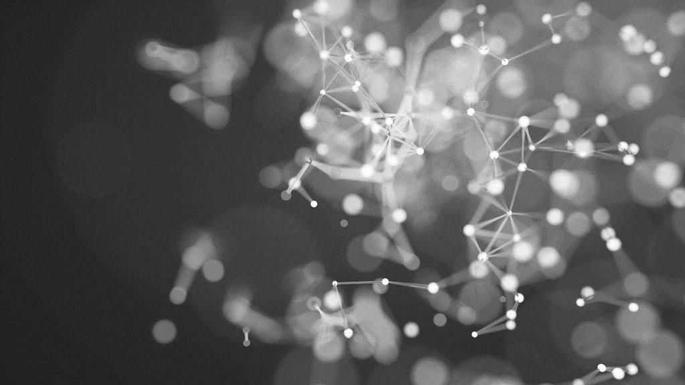
Segmentation using deep learning
Computer Vision
Mohsin Mohammed

Slide 2

Agenda
INTRODUCTION TO SEGMENTATION
OVERVIEW OF DEEP LEARNING
TRADITIONAL METHODS OF DEEP LEARNING
CONVOLUTIONAL NEURAL NETWORKS
ARCHITECTURES FOR SEGMENTATION
U-NET ARCHITECHTURE
APPLICATIONS OF DEEP LEARNING SEGMENTATION
CHALLENGES & LIMITATIONS
FUTURE DIRECTIONS
CONCLUSION

Slide 3
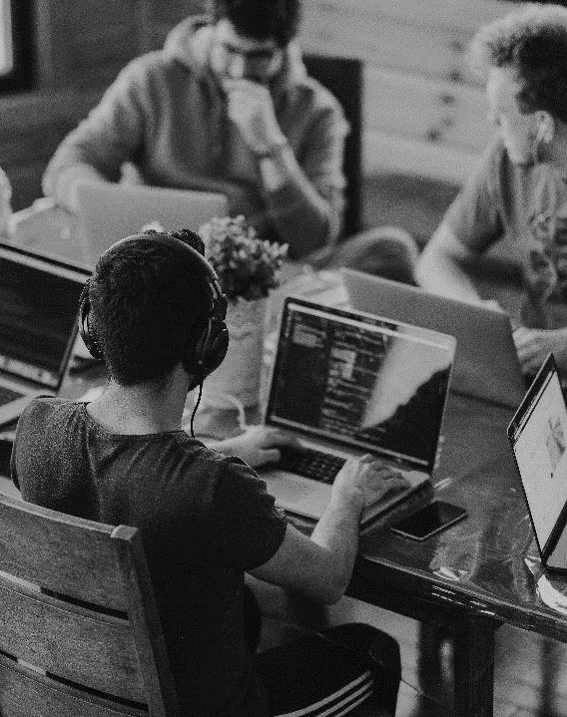
INTRODUCTION
SEGMENTATION
Definition:
“Image segmentation is a method of dividing a digital image into subgroups called image segments. In technical terms it is the assignment of labels to pixels to identify objects, people, or other important elements in the image.” (Datagen)
How it works:
“Function that takes image inputs and produces an output, which is a mask specifying the object class or instance to which each pixel belongs. It can be based on various heuristics like color or contrast” (Datagen)

Slide 4
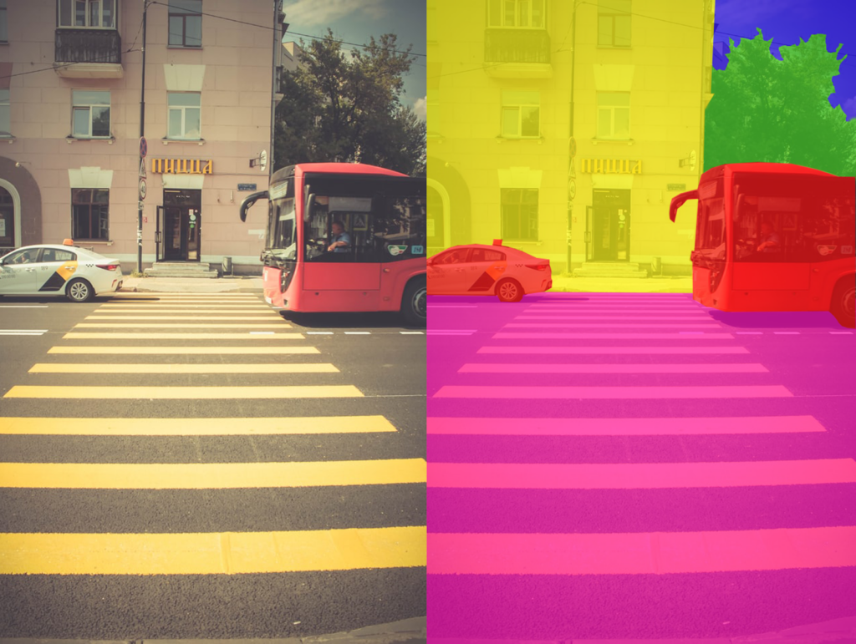
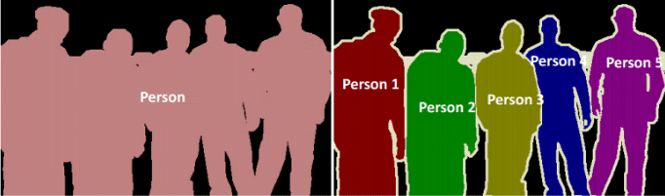
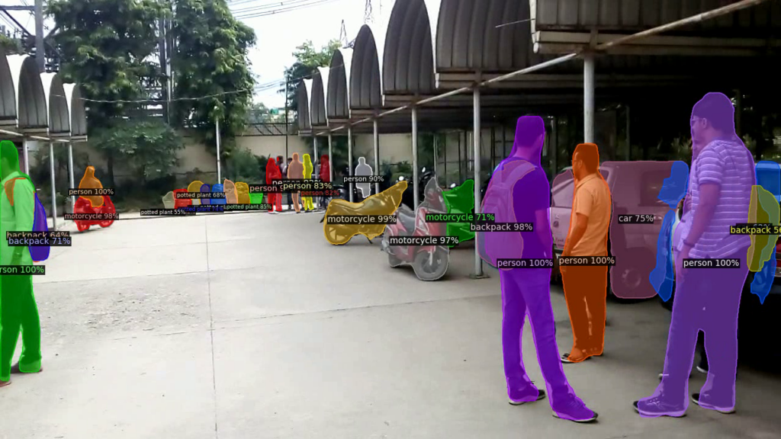
Types of Segmentation
SEMANTIC
Semantic segmentation involves arranging the pixels in an image based on semantic classes.
For example, a segmentation of multiple vehicles and trees will creates a mask that categorizes all types of trees into one class and all types of vehicles into another.
Source: Wikipedia Commons
INSTANCE
Involves classifying pixels based on the instances of an object (as opposed to object classes)
For example, given an image of crowded street, it will locate individual objects within the crowd identifying the number of instances.
Source: ResearchGate
PANOPTIC
Newer type of segmentation, a combination of semantic and instance segmentation. It predicts the identity of each object, segregating every instance of each object in the image.
Importance of Segmentation:
Self-driving cars capture and understand their surroundings quickly and accurately by feeding a live stream of images to a panoptic segmentation algorithm.
Source: kharshit

Slide 5

Overview of deep learning
Definition: Deep learning is a subset of machine learning methods based on artificial neural networks (ANNs) with representation learning. It uses multiple layers in the network to extract higher-level features from raw input.
Key Concepts
Neural Networks: The building blocks of deep learning, inspired by biological brains, using multilayer neural networks to solve machine learning tasks.
Layers: Deep learning networks consist of multiple layers of interconnected nodes, each layer transforming the input data to extract higher-level features ​
Activation Functions: Functions that introduce non-linearity into the network, allowing it to learn complex nonlinear functions
Applications: computer vision, speech recognition, NLP..and more
Source: medium

Slide 6
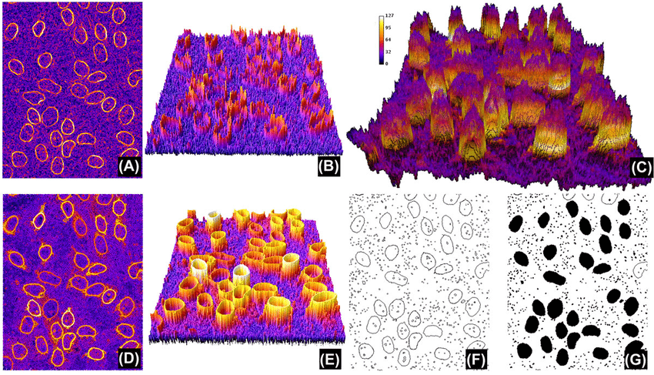
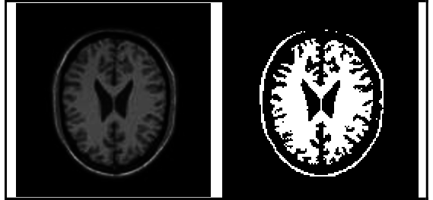

Traditional Methods to deep learning
Thresholding:
One of the easiest, where a threshold is set for dividing the pixel intensities into two classes, 1 if the pixel values are greater than the threshold and 0 otherwise.
Results in a binary map of the image which helps in algorithms like contour detection and identification which only work on binary images
Disadvantages: Simple but struggles with complex images where pixel values of different classes are not easily separable​
Region Based Segmentation:
Look for similarities between adjacent pixels and grouping them under a common class.
Segmentation starts by having some seed pixels and detecting immediate boundaries of seed pixels as being similar or dissimilar
Disadvantages: can be sensitive to noise and may not accurately capture object boundaries​
Edge Segmentation:
Also called edge detection, is the task of detecting edges in images
Canny edge detection is the most popular edge detection
Disadvantages: may not fully segment objects, especially in images with weak or noisy edges​
Clustering based Segmentation :
Make use of clustering algorithms like K-means for segmentation by taking all the pixels into consideration and clustering them into ‘K’ classes
Disadvantages: May still struggle with complex images where clusters are not well-defined
Source: ResearchGate
Source: v7
Source: ResearchGate

Slide 7
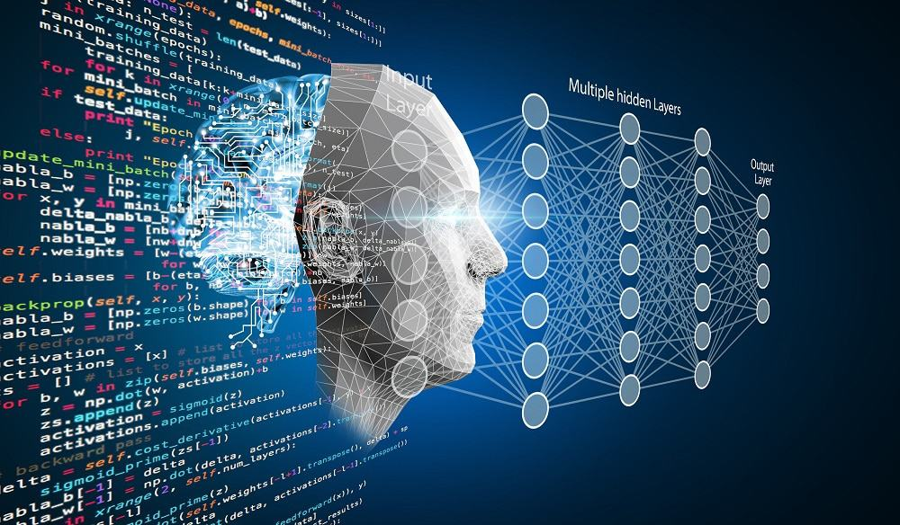
Advantages of deep learning for segmentation
Accuracy: Deep learning models, particularly convolutional neural networks (CNNs), have shown superior accuracy in segmenting complex images by learning hierarchical features​​.
Automation: Deep learning models can automatically learn features from data, reducing the need for manual feature engineering​​.
Flexibility: Deep learning models can be adapted to various segmentation tasks, including semantic, instance, and panoptic segmentation, providing detailed and informative segmentation maps​

Slide 8
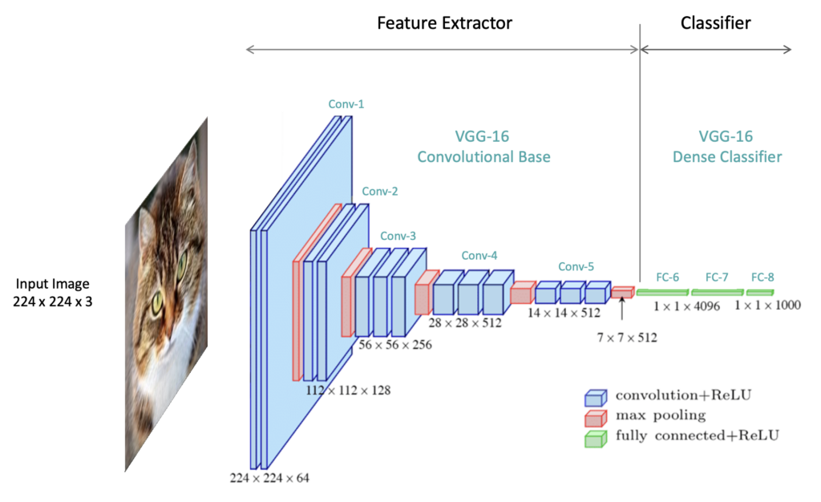
Convolutional neural networks
Introduction to CNNs:
CNNs are a class of deep learning neural networks specifically designed for processing structured grid data, such as images​​.
They are particularly effective for image processing tasks due to their ability to automatically learn spatial hierarchies of features from input images​​.
Feature Extraction and Representation Learning:
CNNs use convolutional layers to extract features from images. These layers apply filters to the input to create feature maps that highlight specific features in the input​.
As the image data passes through the convolutional layers, the network learns to detect edges, textures, and patterns, which are then used for classification or other image processing tasks​
Source: learnopencv

Slide 9
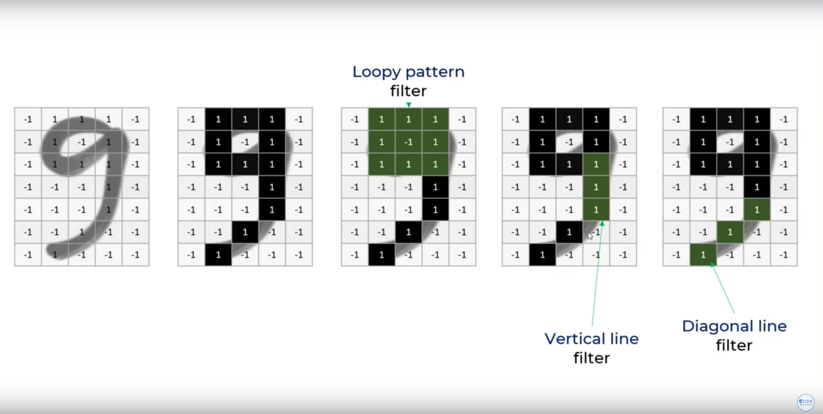
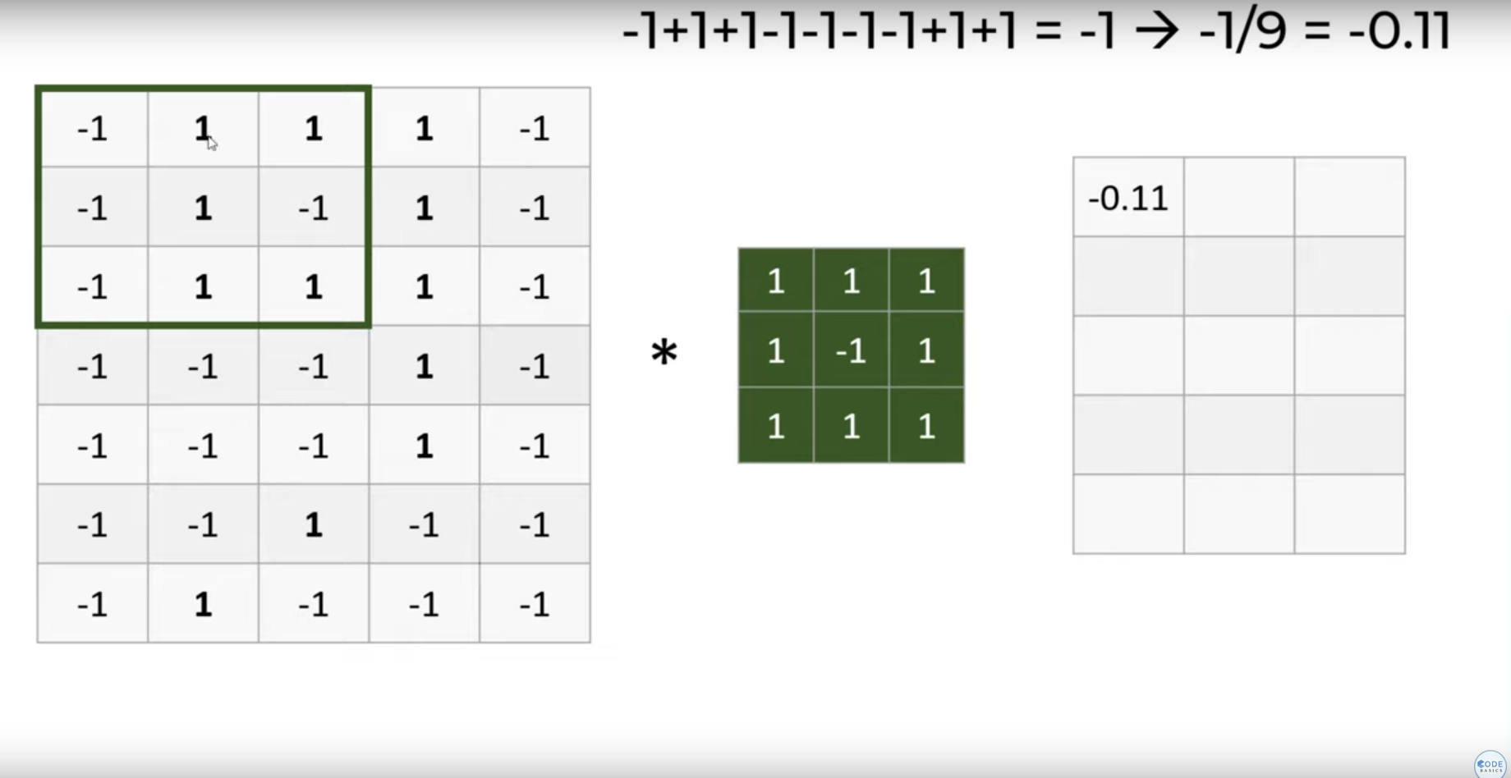
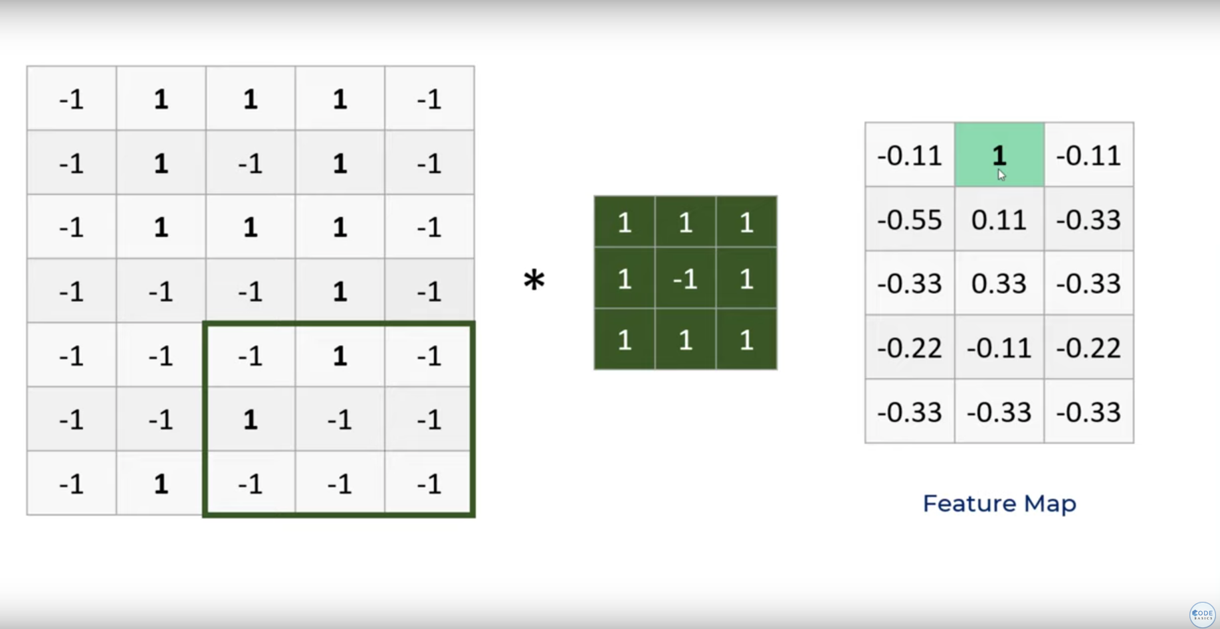
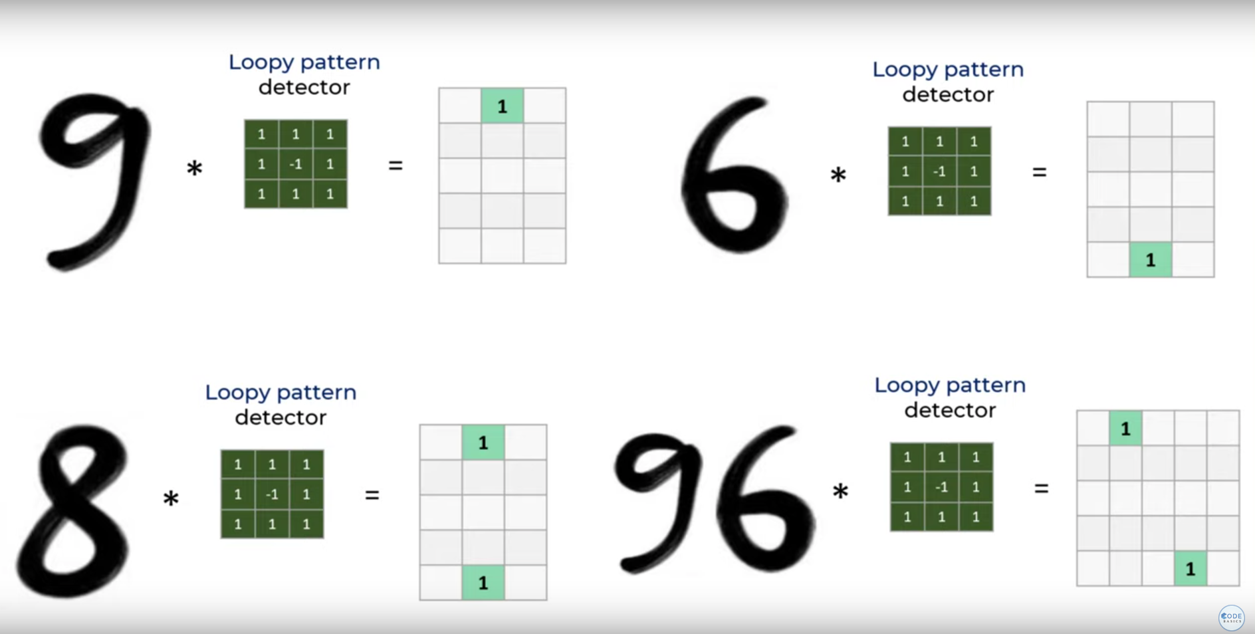
Convolutional neural networks: Convolutional layers

Slide 10
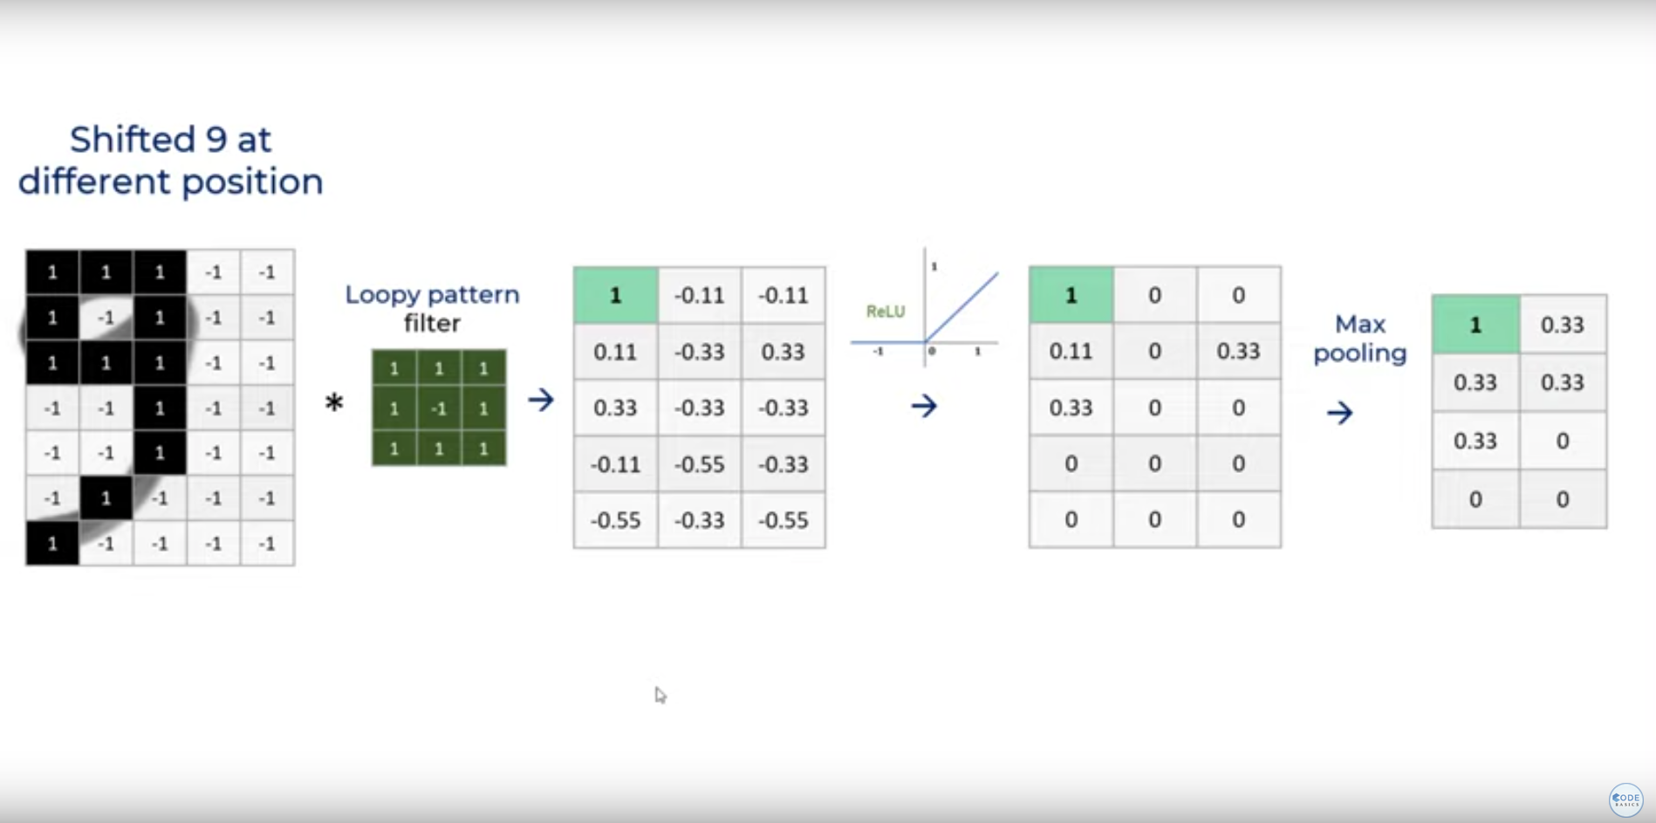
Convolutional neural networks: Convolutional layers

Slide 11
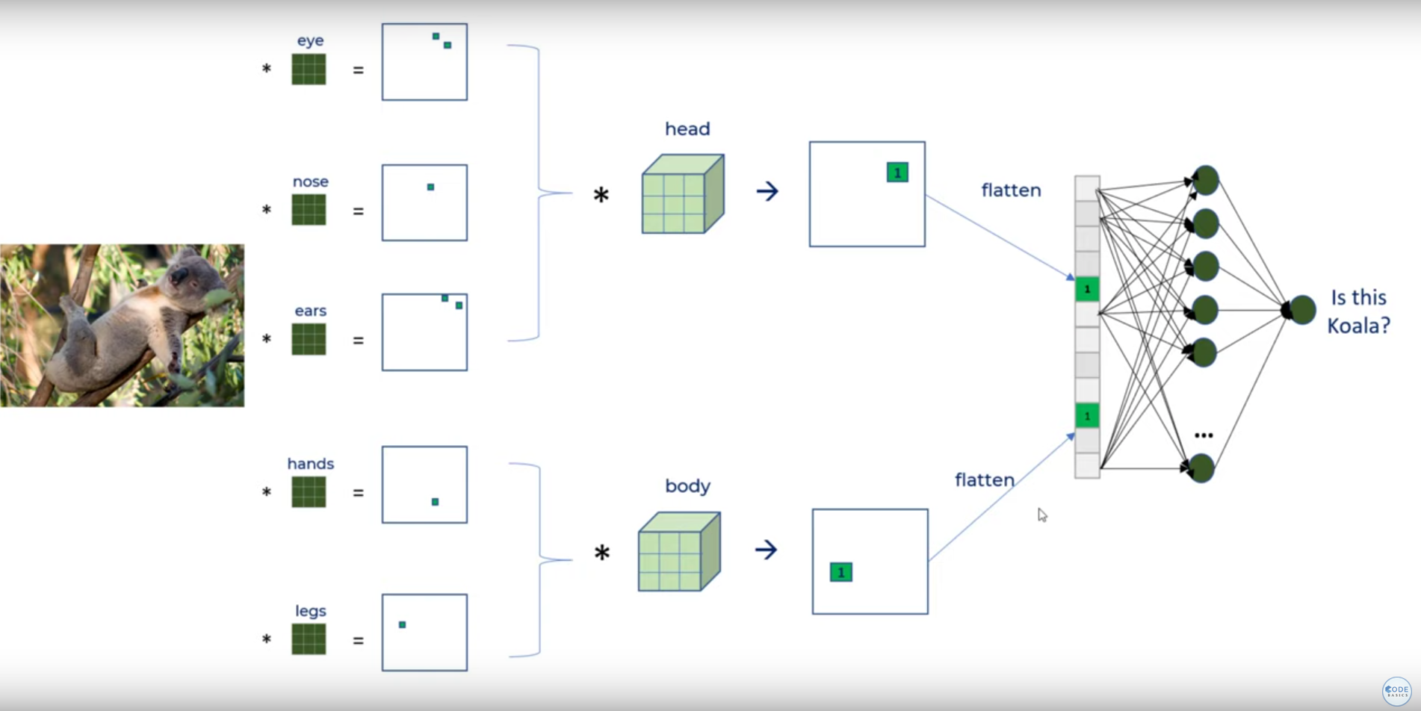
Convolutional neural networks
Source: codebasics

Slide 12
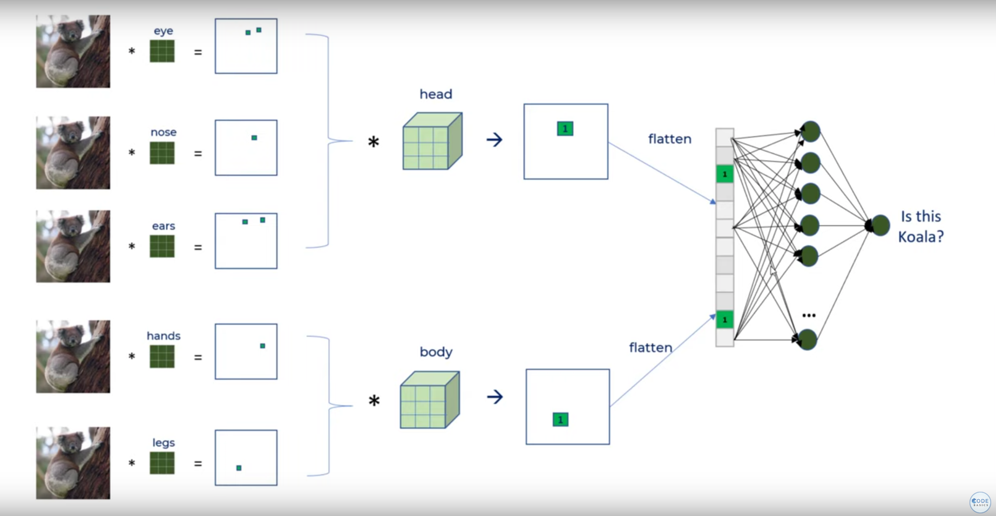
Convolutional neural networks

Slide 13
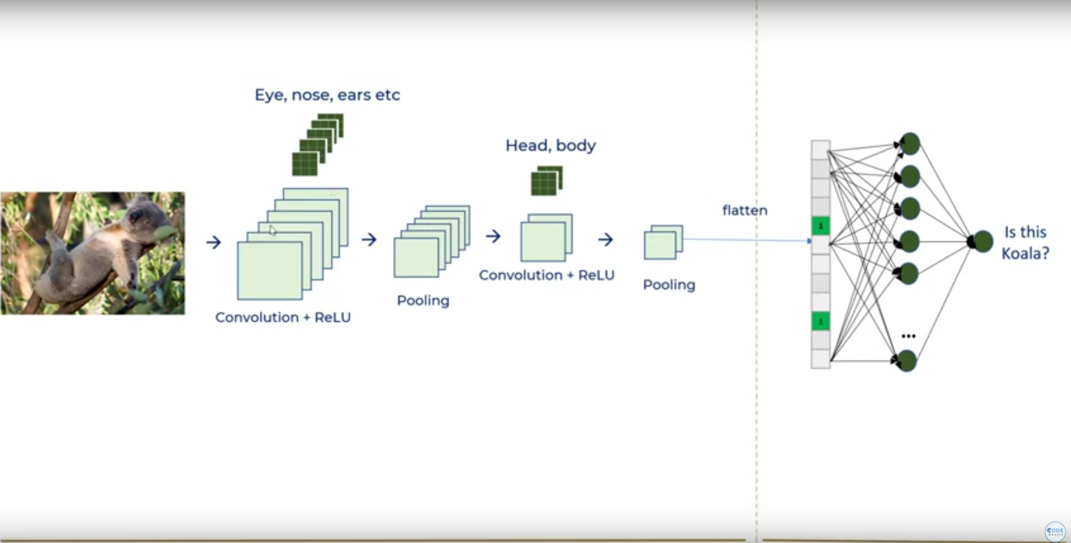
Convolutional neural networks

Slide 14
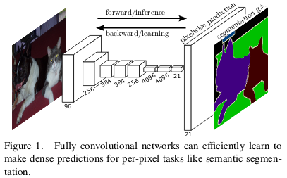
Deep learning - Key architectures for segmentation
Fully Convolutional Networks (FCNs): Modifies the standard CNN architecture to make it suitable for spatial tasks like semantic segmentation, where the goal is to assign a label to each pixel of the image. FCNs achieve this by replacing the fully connected layers of a standard CNN with convolutional layers, allowing them to output spatial maps instead of classification scores. This means FCNs can take input images of any size and produce correspondingly-sized output maps. Additionally, FCNs often incorporate up sampling and skip connections to combine deep, semantic information with shallow, spatial information to produce detailed segmentations.
Source: Kharshit

Slide 15
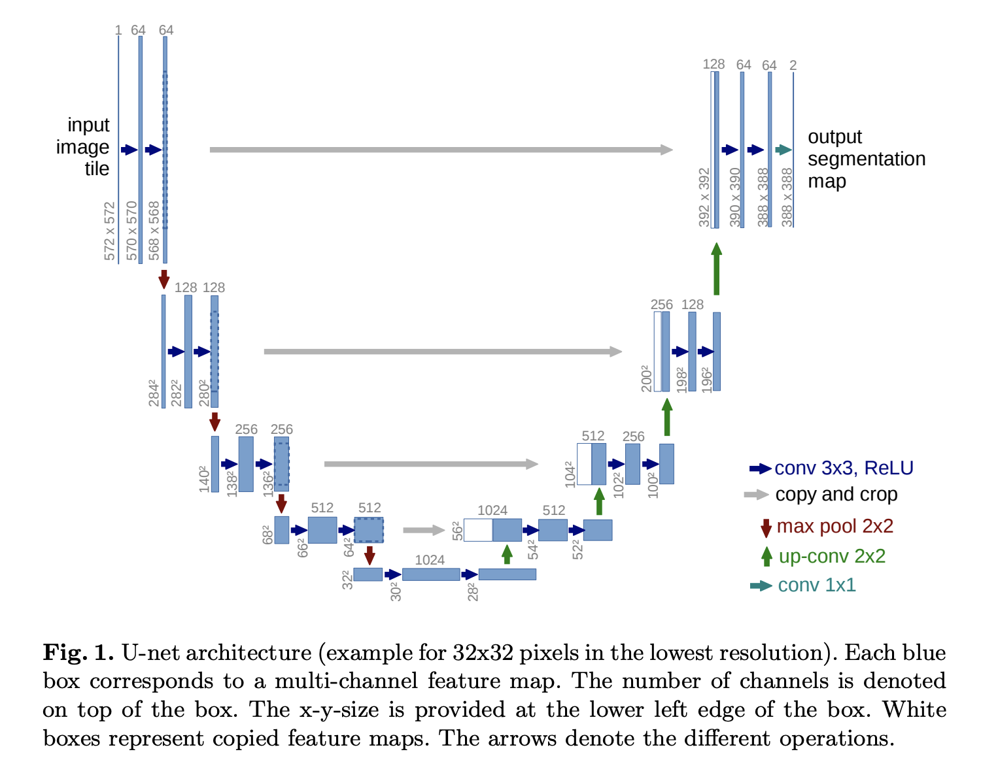
Deep learning - Key architectures for segmentation
U-Net: U-Net is designed specifically for medical image segmentation. It features a symmetric encoder-decoder network that uses skip connections to recover spatial information lost during down sampling. It's particularly effective for biomedical applications due to its efficiency in learning from a limited number of samples.
It consists of a contracting path and an expansive path. The contracting path follows the typical architecture of a convolutional network. It consists of the repeated application of two 3x3 convolutions (unpadded convolutions), each followed by a rectified linear unit and a 2x2 max pooling operation with stride 2 for down sampling. At each down sampling step we double the number of feature channels.
Every step in the expansive path consists of an up sampling of the feature map followed by a 2x2 convolution (“up-convolution”) that halves the number of feature channels, a concatenation with the correspondingly cropped feature map from the contracting path, and two 3x3 convolutions, each followed by a ReLU.

Slide 16
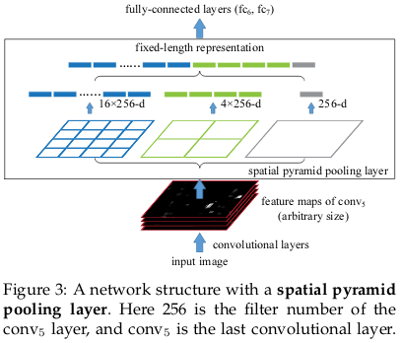
Deep learning - Key architectures for segmentation
DeepLab: Encoder decoder structure.
DeepLab utilizes atrous convolution to capture multi-scale context by adopting multiple atrous rates, alongside spatial pyramid pooling to handle objects at various scales. DeepLabv3+ improves this further by adding a decoder module that refines the segmentation results along object boundaries.
Spatial Pyramid pooling: The solution to deal with variable sized images is to train the model on various scales of the input image to capture multi-scale contextual information.
The different output vectors are concatenated to form a fixed (4x4+2x2+1) x 256 = 5376 dimension vector

Slide 17
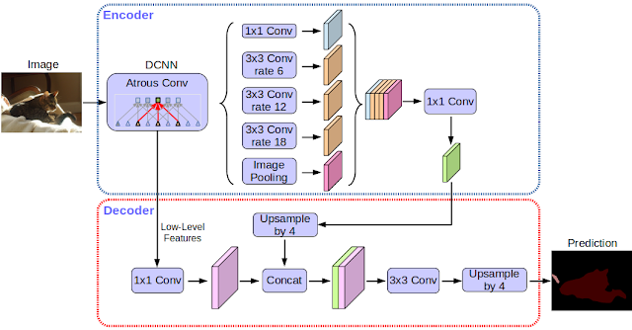
Deep learning - Key architectures for segmentation
DeepLab:
Atrous Convolutions: Unlike the normal convolution, dilation or atrous convolution has one more parameter called dilation or atrous rate, r, which defines the spacing between the values in a kernel. Usually 6, 12 or 18.
it enlarges field of view of filters to incorporate larger context without increasing the number of parameters.

Slide 18
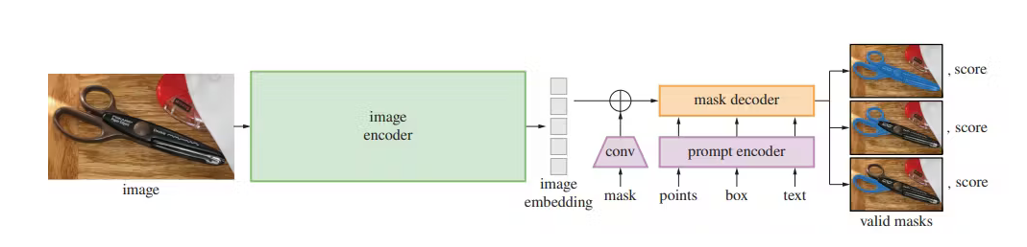
Deep learning - Key architectures for segmentation
Segment Anything Model:
Built on the largest segmentation dataset to date, with over 1 billion segmentation masks.
Return a valid segmentation mask for any prompt, where a prompt can be foreground/background points, a rough box or mask, freeform text, or general information indicating what to segment in an image.
An image encoder produces a one-time embedding for the image, while a lightweight encoder converts any prompt into an embedding vector in real time
These two information sources are combined in a lightweight decoder that predicts segmentation masks.‍
Source: encord

Slide 19
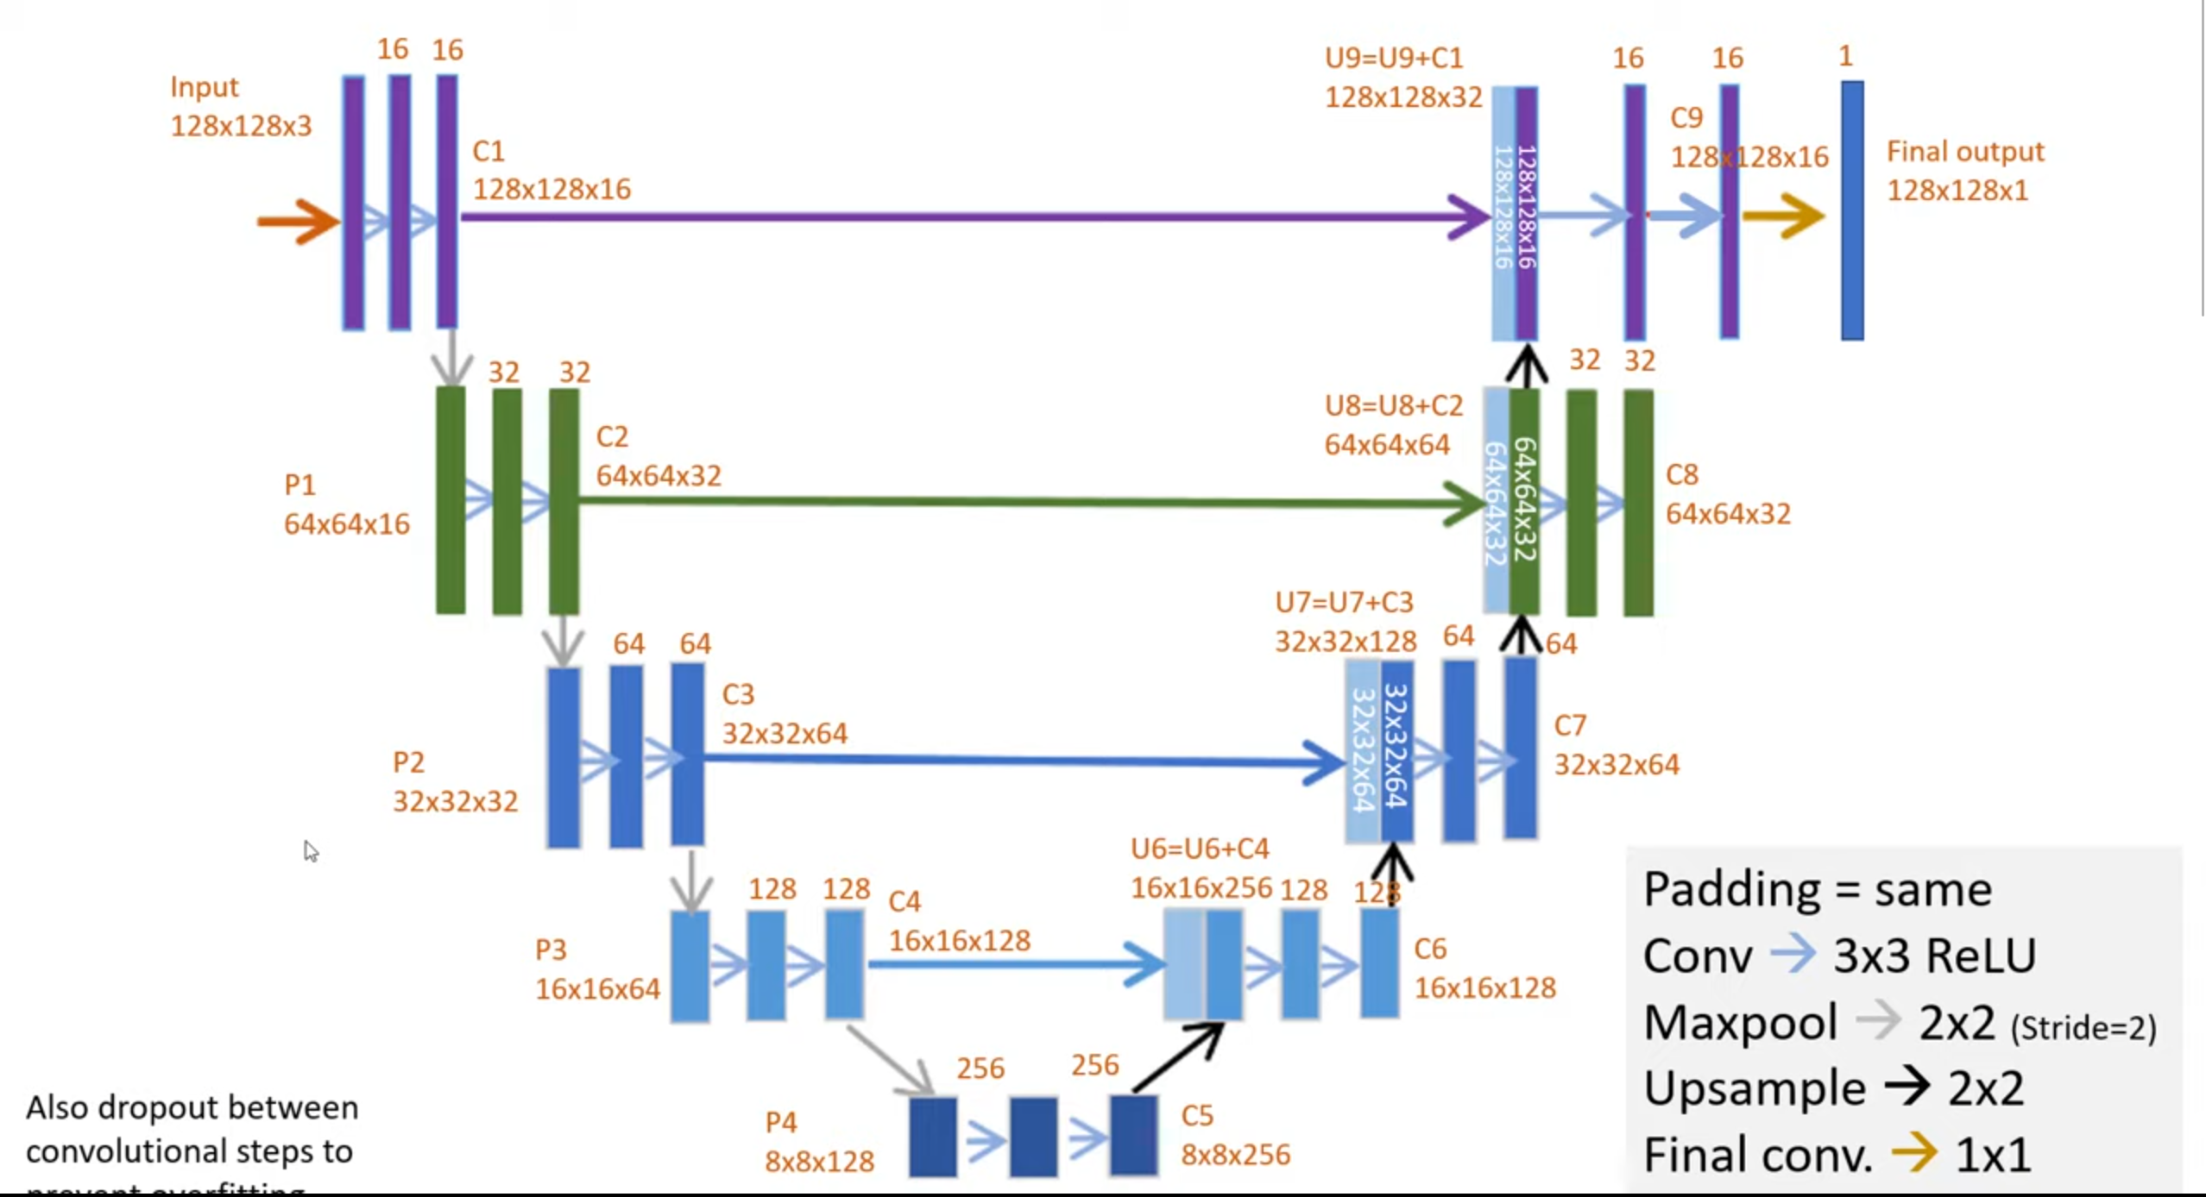
Deep learning : U-net architecture Analysis
Source: digitalSreeni

Slide 20
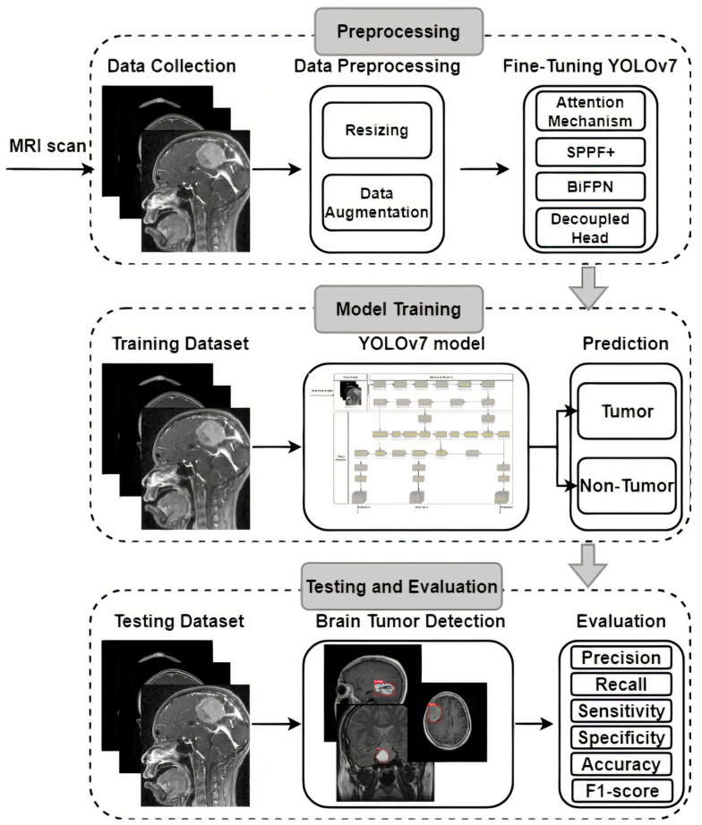
Applications of deep learning segmentation
Medical imaging (tumor detection, organ segmentation)
Autonomous driving (road and obstacle segmentation)
Agricultural monitoring (crop and weed segmentation)
Source: Frontiers
Source: ncbi

Slide 21
Challenges and limitations of deep learning segmentation
Data Requirements: large amounts of labeled data for training. In tasks like medical image segmentation, obtaining labeled data can be expensive and time-consuming.
Annotation Quality: segmentation depends heavily on the quality of the annotations (labels & classes ) used for training. Inconsistent or inaccurate annotations can lead to poor model performance.
Model Complexity: models have millions of parameters which increase computational resources.
Interpretability: Deep learning models often considered black boxes making it hard to understand.
Adversarial Attacks: Deep learning models can be susceptible to adversarial attacks, where small perturbations to the input can lead to incorrect predictions. This can be a security concern in certain applications
Ethical Considerations: In applications like facial recognition or surveillance, there are ethical considerations related to privacy and bias that need to be addressed.

Slide 22

Deep learning segmentation - Future Direction
Auto-Segmentation: Moving towards fully automated segmentation without human intervention.
Meta's SAM: Utilizing Meta's Segment Anything Model (SAM) for remarkable performance in both interactive and automatic segmentation tasks.
Hybrid approaches : Researchers are developing hybrid models that combine deep learning with traditional techniques. For example, some approaches use clustering or thresholding to initialize deep learning models or post-process segmentation results.
LOOKING AHEAD

Slide 23
Conclusion
In conclusion, deep learning has significantly advanced the field of segmentation, offering powerful tools for automatic feature extraction and pattern recognition. Despite challenges such as data requirements, model complexity, and generalization, deep learning models like U-Net and SAM have shown remarkable performance in various applications, including medical imaging and autonomous driving. Future directions include leveraging transfer learning, generative models, and addressing ethical considerations. As research progresses, deep learning-based segmentation is expected to continue transforming industries and enhancing decision-making processes.

Slide 24
Deep learning segmentation - References
Liu, D., Zhang, D., Wang, L., & Wang, J. (2023). Semantic segmentation of autonomous driving scenes based on multi-scale adaptive attention mechanism. Frontiers in Neuroscience, 17. https://doi.org/10.3389/fnins.2023.1291674
Abdusalomov AB, Mukhiddinov M, Whangbo TK. Brain Tumor Detection Based on Deep Learning Approaches and Magnetic Resonance Imaging. Cancers (Basel). 2023 Aug 18;15(16):4172. doi: 10.3390/cancers15164172. PMID: 37627200; PMCID: PMC10453020.
Kromydas, B., & Kromydas, B. (2024, February 5). Understanding Convolutional Neural Network: A Complete guide. LearnOpenCV – Learn OpenCV, PyTorch, Keras, Tensorflow With Code, & Tutorials. https://learnopencv.com/understanding-convolutional-neural-networks-cnn/
Bresnick, J. (2019, December 18). What is deep learning and how will it change healthcare? HealthITAnalytics. https://healthitanalytics.com/features/what-is-deep-learning-and-how-will-it-change-healthcare
Bandyopadhyay, H. (2023, April 24). An Introduction to Image Segmentation: Deep Learning vs. Traditional [+Examples]. V7. https://www.v7labs.com/blog/image-segmentation-guide#applications-of-image-segmentation
Kumar, H. (2019, August 9). Quick intro to semantic segmentation: FCN, U-Net and DeepLab. https://kharshit.github.io/blog/2019/08/09/quick-intro-to-semantic-segmentation
codebasics. (2020, November 30). Image classification vs Object detection vs Image Segmentation | Deep Learning Tutorial 28 [Video]. YouTube. https://www.youtube.com/watch?v=taC5pMCm70U
DigitalSreeni. (2019, December 3). 73 - Image Segmentation using U-Net - Part1 (What is U-net?) [Video]. YouTube. https://www.youtube.com/watch?v=azM57JuQpQI
Wikipedia contributors. (2024, February 20). Deep learning. Wikipedia. https://en.wikipedia.org/wiki/Deep_learning
Choudhary, K., DeCost, B., Chen, C., Jain, A., Tavazza, F., Cohn, R., WooPark, C., Choudhary, A., Agrawal, A., Billinge, S. J. L., Holm, E. A., Ong, S. P., & Wolverton, C. (2022). Recent advances and applications of deep learning methods in materials science. Npj Computational Materials, 8(1). https://doi.org/10.1038/s41524-022-00734-6
Alzubaidi, L., Zhang, J., Humaidi, A. J., Al-Dujaili, A. Q., Duan, Y., Al-Shamma, O., Santamaría, J., Fadhel, M. A., Al-Amidie, M., & Farhan, L. (2021). Review of deep learning: concepts, CNN architectures, challenges, applications, future directions. Journal of Big Data, 8(1). https://doi.org/10.1186/s40537-021-00444-8
Acharya, A. (2023, October 27). Guide to Image Segmentation in Computer Vision: Best Practices. Encord. https://encord.com/blog/image-segmentation-for-computer-vision-best-practice-guide/

Slide 25
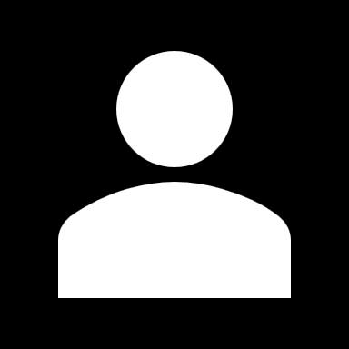
THANK YOU Any questions?
Mohsin Mohammed

